Slide 1
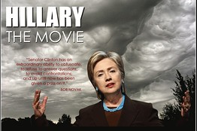
THE hot 1A case: Citizens United v. Federal Elections Commission (Jan. 21, 2010)
“Hillary: The Movie”
At issue: Whether federal campaign finance laws apply to a critical feature-length film about Senator Hillary Clinton intended to be shown in theaters and on-demand to cable subscribers
After hearing argument last Term, the Court ordered re-argument, to focus on the constitutionality of limiting corporations’ independent spending during campaigns for the Presidency and Congress

Slide 2
So long, campaign finance limitations for corporations and non-profits…
Decision came down along party lines, 5-4
Majority opinion used the term “blog” for the first time!
Kennedy: Restrictions on independent political spending cannot rely on the identity of the speaker
Spending money = speaking
Corporations are no longer barred from spending their own in-house cash on politics
Application to labor unions?
Bitter dissent by Stevens: Corporations should NOT be treated as human beings
“The Court’s blinkered and aphoristic approach to the First Amendment may well promote corporate power at the cost of the individual and collective self-expression the Amendment was meant to serve. It will undoubtedly cripple the ability of ordinary citizens, Congress, and the States to adopt even limited measures to protect against corporate domination of the electoral process.”

